Slide 1

SOCIONICS
All slides are copyrighted by Jack Oliver Aaron of the World Socionics Society
A CRASH COURSE

Slide 2
7. ALPHA

Slide 3
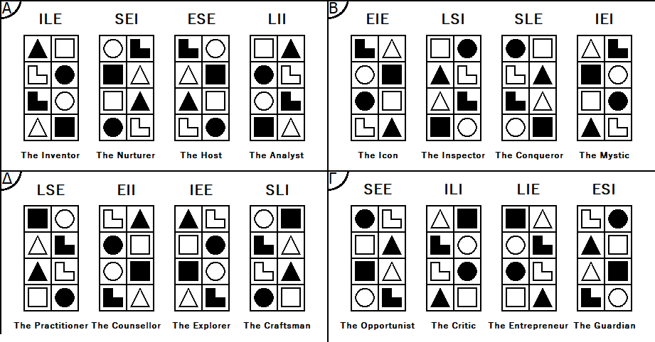
SO FAR
All slides are copyrighted by Jack Oliver Aaron of the World Socionics Society
Elements
Functions
Types

Slide 4
WHAT’S NEXT
All slides are copyrighted by Jack Oliver Aaron of the World Socionics Society
Elements
Functions
Types
ILE, SEI, ESE & LII

Slide 5
ALPHA VALUES
All slides are copyrighted by Jack Oliver Aaron of the World Socionics Society
All Valued Elements are Attractive.
Understanding the world in a simple and symmetrical way
Sharing new ideas, exciting insights and beautiful experiences with others
Including everyone and bringing them together
Keeping things casual, fun, easygoing and down-to-earth

Slide 6
ALPHA TABOOS
All slides are copyrighted by Jack Oliver Aaron of the World Socionics Society
All Neglected Elements are Repulsive.
Being too serious, saying ‘no’, rather than entertaining new ideas
Feeling better or smarter than anyone else, arrogance, double standards
Letting personal disagreements ruin the mood for others
Intense disruptions and upheavals, any messy, ad hoc thinking

Slide 7


ALPHA SOCIALITES
All slides are copyrighted by Jack Oliver Aaron of the World Socionics Society
Emotions should be positive Sensations should be comfortable Life should be enjoyed together Experiences should be beautiful
The Nurturer - SEI
The Host - ESE

Slide 8
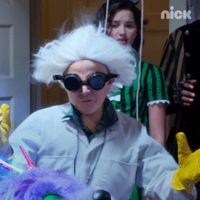
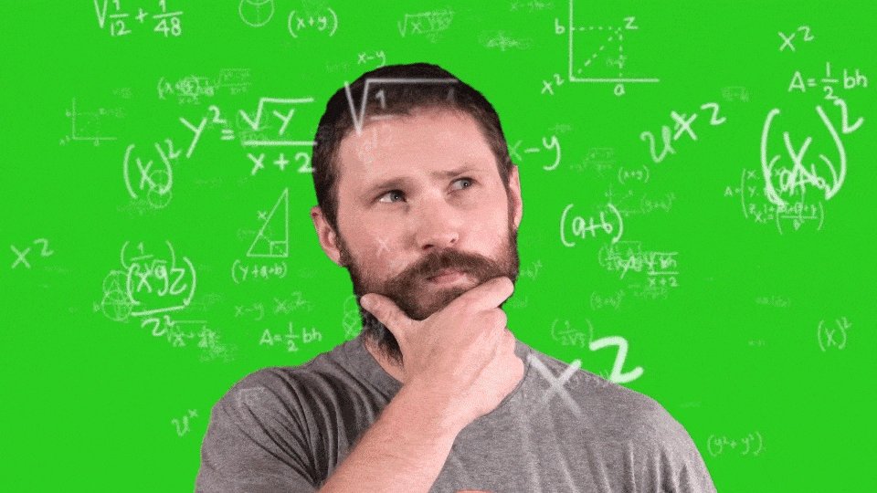
ALPHA INTELLECTUALS
All slides are copyrighted by Jack Oliver Aaron of the World Socionics Society
Ideas should make sense Theories can explain anything Understanding should be broadened Truth can be joined up in new ways
The Inventor - ILE
The Analyst - LII

Slide 9



ALPHA ENERGISERS
All slides are copyrighted by Jack Oliver Aaron of the World Socionics Society
Say ‘Yes’ to things The more the merrier Don’t miss out on things Create excitement around new ideas
The Inventor - ILE
The Host - ESE

Slide 10
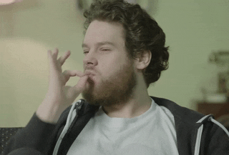
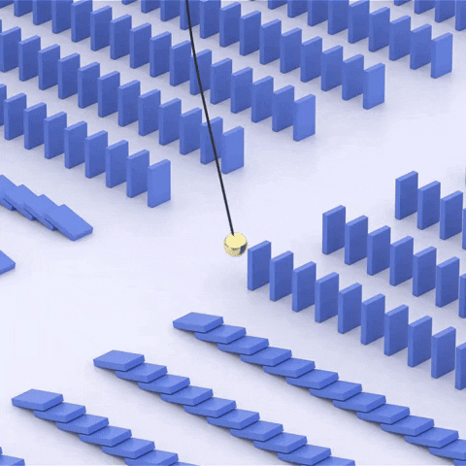

ALPHA INTEGRATORS
All slides are copyrighted by Jack Oliver Aaron of the World Socionics Society
Maintain comfort and stability Pursue simple elegance in all things Avoid pressure, ugliness and disruption Things must fit together and make sense
The Nurturer - SEI
The Analyst - LII

Slide 11
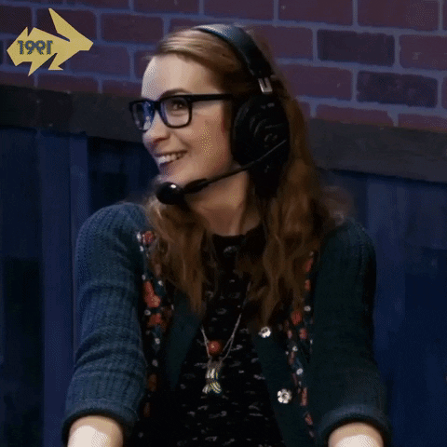
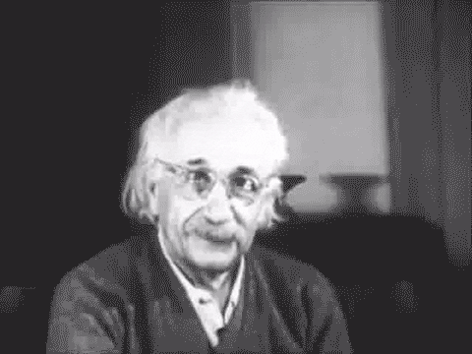

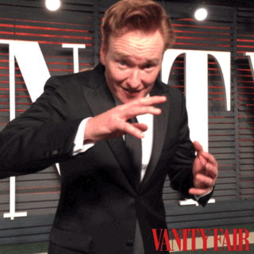

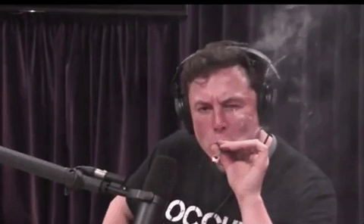
INTUITIVE LOGICAL ENERGISER - “THE INVENTOR”
All slides are copyrighted by Jack Oliver Aaron of the World Socionics Society

Slide 12
EGO BLOCK
All slides are copyrighted by Jack Oliver Aaron of the World Socionics Society
All about exploring new ideas Quickly takes on new interests Sees potential in the unconventional Generates alternative ways of thinking Rapidly makes sense of new things Can explain how ideas fit together Picks out underlying rules and principles Spots inconsistencies and contradictions
Notes:
Carl Sagan I1 + L2: https://www.youtube.com/watch?v=UnURElCzGc0

Slide 13
SUPER-EGO BLOCK
All slides are copyrighted by Jack Oliver Aaron of the World Socionics Society
Dislikes harshness or forcefulness Finds it unnatural to shut things down Need a reason to be tough with others Can engage in short bursts of willpower Often can’t admit they dislike someone Have to justify saying ‘no’ to something Erratic in personal relationships Can neglect those close to them
Notes:
Elon Musk F3 + R4: https://www.youtube.com/watch?v=VvKJzROmu84

Slide 14
SUPER-ID BLOCK
All slides are copyrighted by Jack Oliver Aaron of the World Socionics Society
Frequently messy and scruffy Not good at maintaining day-to-day Can pursue pleasure to excess Very receptive to being made comfortable Like to play up to a crowd Enjoy causing emotional reactions Attempts to win people over can backfire Want fun and for people to like them
Notes:
Boris Johnson S5: https://www.youtube.com/watch?v=f2IsafsIW_8
E6: https://www.youtube.com/watch?v=05FVDmZgskM

Slide 15
ID BLOCK
All slides are copyrighted by Jack Oliver Aaron of the World Socionics Society
Weighs up ideas and their outcomes Hates to miss out or feel limited Only focuses to not miss big possibility Finds another way around inevitability Often relax by absorbing lots of facts Does not expect competence from others Takes their problem-solving for granted Prefers interesting to useful solutions
Notes:
Elon Musk T7+P8: https://www.youtube.com/watch?v=EID64E1t0CE&t=14s

Slide 16
DOMINATION
All slides are copyrighted by Jack Oliver Aaron of the World Socionics Society
Wants to maximise possibilities Insistent on exploring ideas with potential Will not be dissuaded from trying ideas out Only filter out possibilities with low potential May try bad ideas, just in case they work
Notes:
Nicolas Cage I1>T7: https://www.youtube.com/watch?v=eExfV_xKaiM

Slide 17
MASKING
All slides are copyrighted by Jack Oliver Aaron of the World Socionics Society
Strongly prefer ‘out of the box’ approaches Dislike the direct approach but will if needed Prefer to step back, let possibilities flourish Constraints force them to be more forceful
Notes:
Boris Johnson I1 -> F3: https://www.youtube.com/watch?v=kPPyBLC5ddM
Elon Musk I1 -> F3: https://www.youtube.com/watch?v=TNSmO6Fh_pY

Slide 18
STRUGGLE
All slides are copyrighted by Jack Oliver Aaron of the World Socionics Society
Reluctantly adapt to worldly pressures See the world as requiring them to be tough Feel they have to become more disciplined Desire people who are calm and laid back Freed by comforting, maintained surroundings
Notes:
Elon Musk F3 > F5: https://www.youtube.com/watch?v=EID64E1t0CE
Elon Musk F3 > F5: https://www.youtube.com/watch?v=Wwt4Hdp-MKg

Slide 19
DISTRACTION
All slides are copyrighted by Jack Oliver Aaron of the World Socionics Society
Normally in pursuit of hedonic pleasure Become very ascetic when having to focus Neglect their daily needs, not eating, sleeping Need to get through bottleneck to relax again
Notes:
Elon Musk S5 -> T7: https://www.youtube.com/watch?v=xbiApOBuRjo

Slide 20
MASTERY
All slides are copyrighted by Jack Oliver Aaron of the World Socionics Society
Rapidly acquires factual information Great at balancing theoretical and practical Bolsters theories with factual research Restructures theories so they make sense Able to quickly understand, explain and apply
Notes:
Hank Green L2<P8: https://www.youtube.com/watch?v=0LUiYrwKQS8&t=137s

Slide 21
GROWTH
All slides are copyrighted by Jack Oliver Aaron of the World Socionics Society
Take facts for granted, want to be loved Become more ‘showy’, less factual over time Playing up to the crowd can backfire Regress to less exciting, practical matters
Notes:
Elon Musk P8 -> E6: https://www.youtube.com/watch?v=VmGPG6NONKM&t=11s

Slide 22
SUBSTITUTION
All slides are copyrighted by Jack Oliver Aaron of the World Socionics Society
See objective rules, not subjective attitudes Default to logical criteria in personal matters Need a rational justification for liking/disliking Handle relationships with rules and categories
Notes:
Albert Einstein R4 -> L2: https://www.youtube.com/watch?time_continue=12&v=C2Y-XGcBwWc

Slide 23
HUBRIS
All slides are copyrighted by Jack Oliver Aaron of the World Socionics Society
Blind to their personal attitudes, likes, dislikes Yet want people to shower them with love Pursue public recognition and popularity Overlook closer relationships, can be disloyal May lose public support due to personal life
Notes:
Boris Johnson R4<E6: https://www.youtube.com/watch?v=-Axk4cFxDas
Boris Johnson: R4<E6 https://www.youtube.com/watch?v=jJfn3Tgj4rw

Slide 24
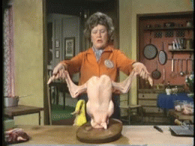
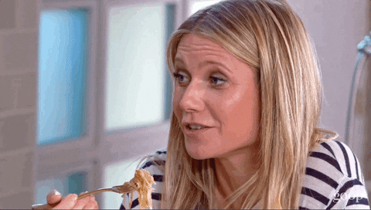
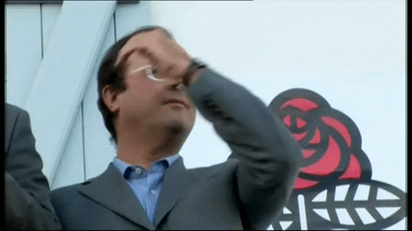
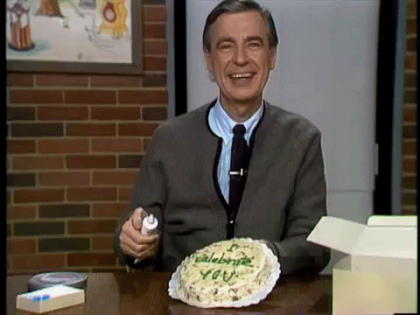
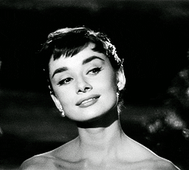
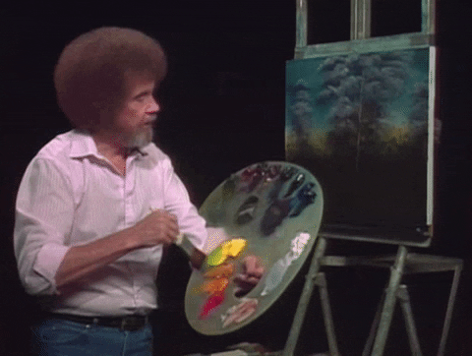
SENSORY ETHICAL INTEGRATOR - “THE NURTURER”
All slides are copyrighted by Jack Oliver Aaron of the World Socionics Society

Slide 25
EGO BLOCK
All slides are copyrighted by Jack Oliver Aaron of the World Socionics Society
All about comfort, enjoying the moment Balances local details into harmony Seeks balance, follows a natural pace Smooths over stress and ugliness Needs people to be happy and get along Adapts to social norms, doesn’t stick out Can cheer people up, reduce tensions Wants experiences to be fun, enjoyable
Notes:
Bob Ross S1+E2: https://www.youtube.com/watch?v=FX2AEfZpWT8

Slide 26
SUPER-EGO BLOCK
All slides are copyrighted by Jack Oliver Aaron of the World Socionics Society
Dislikes those who can’t smell the roses Finds it unnatural to detach from present Need a social reason to look at big picture Can reflect somewhat on likely outcomes Struggle to process lots of facts Find it stressful to update how to do things Not data-driven, do what ‘works’ for them Ignorant beyond personal experiences
Notes:
Nero T3+P4: https://www.youtube.com/watch?time_continue=83&v=-q6Js49KYUg
14th Dalai Lama: https://www.youtube.com/watch?v=zKPM5OaOXH8

Slide 27
SUPER-ID BLOCK
All slides are copyrighted by Jack Oliver Aaron of the World Socionics Society
Can get stuck in their comfort zone Uncertain about new ideas or influences Want to be shown new experiences Very receptive to unfamiliar perspectives Like to understand things clearly Enjoy carving out an area of expertise Attempts to show understanding can fail Want people to see they are not stupid
Notes:
Gwyneth Paltrow I5+L6: https://www.youtube.com/watch?v=MunlAm7IGsE

Slide 28
ID BLOCK
All slides are copyrighted by Jack Oliver Aaron of the World Socionics Society
Reads the tension and power dynamics Hates harshness or aggression Can explode if very uncomfortable Keeps people happy to avoid conflict Inwardly sensitive and get hurt feelings Often relax by seeing their close friends Forgiving, but know people’s intentions Frequently very secure in relationships
Notes:
Jonah Hill F7+R8: https://www.youtube.com/watch?v=DdTuIF1sh6Q

Slide 29
DOMINATION
All slides are copyrighted by Jack Oliver Aaron of the World Socionics Society
Wants to minimise tension and disharmony Insists on the right balance of sensory stimuli Will not be pushed out of their natural pace Only grow assertive when uncomfortable May become submissive to avoid disapproval
Notes:
Gwyneth Paltrow S1>F7: https://www.youtube.com/watch?v=48vJt25NUoE
Fred Rogers S1>F7: https://www.youtube.com/watch?v=dp7mE0_8VP4

Slide 30
MASKING
All slides are copyrighted by Jack Oliver Aaron of the World Socionics Society
Strongly prefer to be in the moment Dislike deep reflection but will if needed Prefer to be in their body, rather than the mind Feel they have to worry about uncertain future
Notes:
14th Dalai Lama: https://www.youtube.com/watch?v=uqOMZP6HPP8

Slide 31
STRUGGLE
All slides are copyrighted by Jack Oliver Aaron of the World Socionics Society
When uncertain, can worry about the future See negative experiences, yet to come Feel some bad things are inevitable Desire people who can think outside the box Freed by learning of exciting, new possibilities
Notes:
Lord North T3>I5: https://www.youtube.com/watch?v=8_1ZictdrQc

Slide 32
DISTRACTION
All slides are copyrighted by Jack Oliver Aaron of the World Socionics Society
Normally like being shown new ideas Become very assertive when uncomfortable Put up barriers, shut out suggestions Need to be comfortable again to open up

Slide 33
MASTERY
All slides are copyrighted by Jack Oliver Aaron of the World Socionics Society
Natural at reading and adapting to the mood Great at balancing group and individual ties Connects each individual to the cluster Ensures that the mood is nice and positive Able to fit in while keeping close relationships
Notes:
Fred Rogers E2<R8: https://www.youtube.com/watch?v=kFVPkn37iFM
Audrey Hepburn: https://www.youtube.com/watch?v=rKgyBw6SHuc&t=29s

Slide 34
GROWTH
All slides are copyrighted by Jack Oliver Aaron of the World Socionics Society
Take bonds for granted, want to understand Grow more coherent, less partial over time Being the ‘expert’ can create a lot of pressure Regress to reliance on close friendships
Notes:
14th Dalai Lama R8>L6: https://www.youtube.com/watch?v=vQ0CoQyIe7Y
Martin Seligman R8>L6: https://www.youtube.com/watch?v=G-D2kDuP-5A

Slide 35
SUBSTITUTION
All slides are copyrighted by Jack Oliver Aaron of the World Socionics Society
See how people feel, not what actually works Default to entertaining rather than informing Need social interactions to learn things Use emotional feedback to decide what works
Notes:
Fred Rogers P4 -> E2: https://www.youtube.com/watch?v=BDojoOiKLuc&t=1s
Bob Ross P4 -> E2: https://www.youtube.com/watch?v=wCsO56kWwTc

Slide 36
HUBRIS
All slides are copyrighted by Jack Oliver Aaron of the World Socionics Society
Blind to how effectively things will work Yet want to understand the world clearly Pursue a niche field they can gain expertise in Rely on experience/ideas that ‘make sense’ May fear their knowledge being challenged
Notes:
Gwyneth Paltrow P4<L6: https://www.youtube.com/watch?v=dxQ4JxQ8_EU

Slide 37
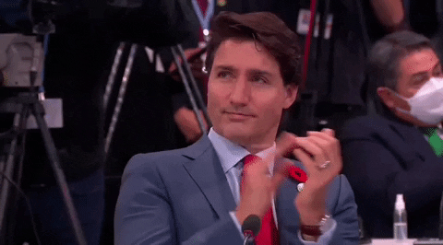
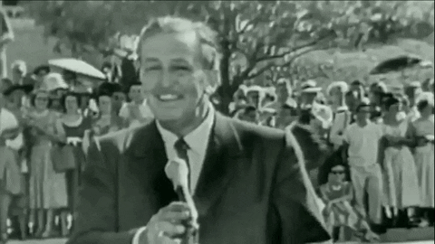
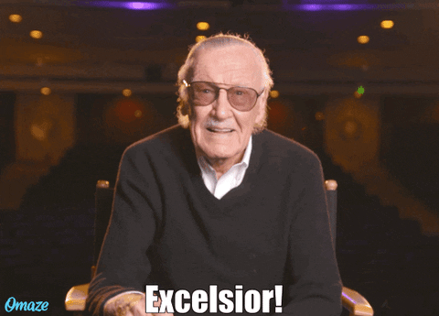
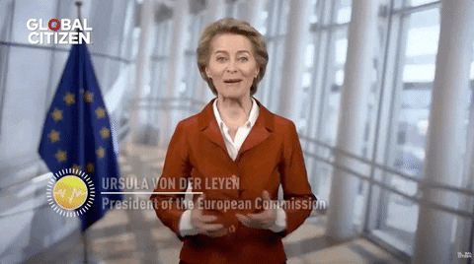
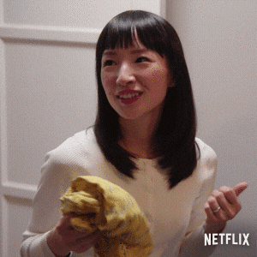

ETHICAL SENSORY ENERGISER - “THE HOST”
All slides are copyrighted by Jack Oliver Aaron of the World Socionics Society

Slide 38
EGO BLOCK
All slides are copyrighted by Jack Oliver Aaron of the World Socionics Society
All about expressing positive emotions Wear their heart on their sleeve Raise up the emotions of others Get others involved and having fun Attentive to how sensations affect mood Rearrange conditions for people Keep mood pleasant and comfortable Good at taking care of others
Notes:
Robin Williams E1+S2: https://www.youtube.com/watch?v=xFGHAhL6yRI
Marie Kondo E1+S2: https://www.youtube.com/watch?v=9AvWs2X-bEA
Hugh Jackman E1+S2: https://www.youtube.com/watch?v=BAqmjiXUaRk

Slide 39
SUPER-EGO BLOCK
All slides are copyrighted by Jack Oliver Aaron of the World Socionics Society
Dislike anything too factual or boring Much prefer to focus on how people feel Can fix problems if there’s a present need Exaggerate facts to express feelings Do not see longer-term outcomes Struggle to think strategically Live moment to moment, lack reflection Can believe in plans doomed to fail
Notes:
Jack Ma P3+T4: https://www.youtube.com/watch?v=aHGd6LqAVzw

Slide 40
SUPER-ID BLOCK
All slides are copyrighted by Jack Oliver Aaron of the World Socionics Society
Thoughts often disconnected Not good at making sense of things Eagerly adopt the theories of others Like bringing together clever people Believe anything is possible Humour often zany and ‘out there’ Generate ideas but lack greater insight Try to include all people and perspectives
Notes:
Robin Williams L5+I6: https://www.youtube.com/watch?v=NulIk9xQ-7I
Matthew McConaughey L5+I6: https://www.youtube.com/watch?v=fWIB_Iymgg0

Slide 41
ID BLOCK
All slides are copyrighted by Jack Oliver Aaron of the World Socionics Society
Aware of relational distances Builds bonds as part of group appeal Focused more on public communication Suspends judgement to involve others Full of positive dynamic energy Can get a lot of things done Use physical activities to relax Fearsome temper, but ashamed of it
Notes:
Tom Cruise R7+F8: https://www.youtube.com/watch?v=bm1gvNQtYJQ
Walt Disney R7+F8: https://www.youtube.com/watch?v=TRu7ka4eD8k
Hugh Jackman F7+E8: https://www.youtube.com/watch?v=pHraxCmFOjA

Slide 42
DOMINATION
All slides are copyrighted by Jack Oliver Aaron of the World Socionics Society
Focused on the positive mood Insist on not being selective, including all Will refuse to make the mood personal Subordinates personal sincerity to image May prioritise public over private life
Notes:
Richard Simmons E1>R7: https://www.youtube.com/watch?v=na9ZZ4ZjVa8
Rolf Harris E1>R7: https://www.youtube.com/watch?v=bLYKkPqvcOY
Will Smith E1>R7: https://www.youtube.com/watch?v=yWdpTbQGh3w

Slide 43
MASKING
All slides are copyrighted by Jack Oliver Aaron of the World Socionics Society
Strongly prefer emotive, uplifting conversation Dislike informing in a dry, matter-of-fact way Wants physical conditions to not upset people If necessary, will do the ‘boring’ practical stuff
Notes:
Ursula Van der Leyen E1 -> P3: https://www.youtube.com/watch?v=5gz9ZvkEEUU
Marie Kondo E1 -> P3: https://www.youtube.com/watch?v=bjUlC8aEb7s

Slide 44
STRUGGLE
All slides are copyrighted by Jack Oliver Aaron of the World Socionics Society
Reluctantly learns facts to become competent Finds too much information unexciting Need something cohesive to feel passion for Want someone to make sense of it all Freed by coherent theories that explain things
Notes:
Tom Cruise P3>L5: https://www.youtube.com/watch?v=UFBZ_uAbxS0

Slide 45
DISTRACTION
All slides are copyrighted by Jack Oliver Aaron of the World Socionics Society
Normally open to objective explanations If people are not happy, give one-to-one time Lose sight of general principles for loyalties Need the mood to be positive to seek logic
Notes:
Will Smith L6 -> R7: https://www.youtube.com/watch?v=6tbyBlelz_A

Slide 46
MASTERY
All slides are copyrighted by Jack Oliver Aaron of the World Socionics Society
Highly conditioned to the local, present day High energy, frequently fit into old age Keeps environment pleasant and comfortable Is also able to think on feet and take action Able to quickly manage present resources
Notes:
Bruce Forsyth S2<F8: https://www.youtube.com/watch?v=EwgklPgkA_M&t=60s
Betty White: https://www.youtube.com/watch?v=INHv5q2W3OU

Slide 47
GROWTH
All slides are copyrighted by Jack Oliver Aaron of the World Socionics Society
Prefer being gentle but could over-assert Become more open, less pushy over time Giving people more freedom can backfire Regress to being tougher, more authoritarian
Notes:
Justin Trudeau F8 -> I6: https://www.youtube.com/watch?v=rxO8QZAdkCY

Slide 48
SUBSTITUTION
All slides are copyrighted by Jack Oliver Aaron of the World Socionics Society
Read present mood, not future outcomes Present harmony not predicted to change Can’t justify spoiling moment for future issues Need responsibility within a clear time frame
Notes:
Justin Trudeau T4 -> S2: https://www.youtube.com/watch?v=ce1wK3DvOTY

Slide 49
HUBRIS
All slides are copyrighted by Jack Oliver Aaron of the World Socionics Society
Blind to how the future will turn out Yet want to offer captivating possibilities Pursue creativity, covering every possibility Believe even the futile is going to be possible May lead to issues or waste time and effort
Notes:
Jack Ma I6>T4: https://www.youtube.com/watch?v=fqWz8ksvowk

Slide 50
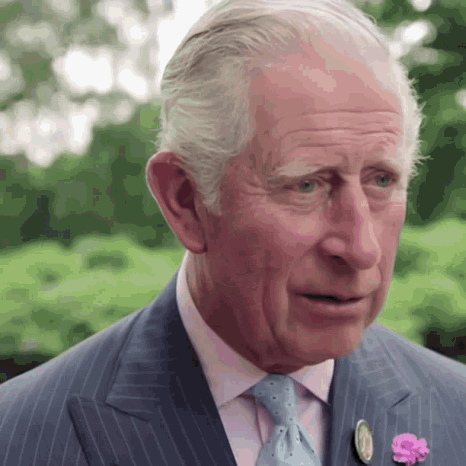
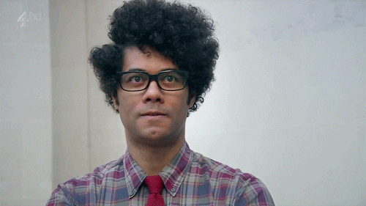
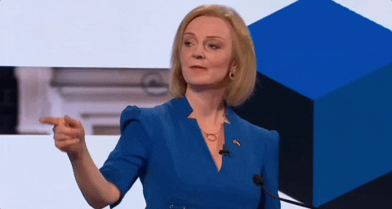

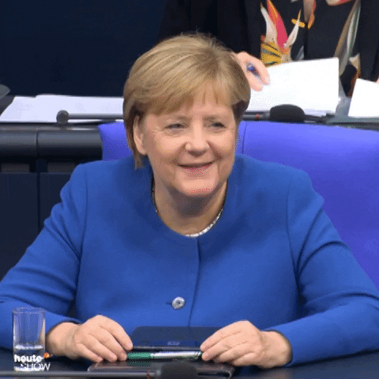

LOGICAL INTUITIVE INTEGRATOR - “THE ANALYST”
All slides are copyrighted by Jack Oliver Aaron of the World Socionics Society

Slide 51
EGO BLOCK
All slides are copyrighted by Jack Oliver Aaron of the World Socionics Society
All about making sense of the universe Pieces ideas into a coherent structure Constructs frameworks of understanding Driven by logical/philosophical principles Open to different ideas and perspectives Looks at theories from different angles Thinks through possible explanations Ideals and beliefs work in theory
Notes:
Douglas Hofstadter L1+I2: https://www.youtube.com/watch?v=hVpzbjyffa8

Slide 52
SUPER-EGO BLOCK
All slides are copyrighted by Jack Oliver Aaron of the World Socionics Society
Dislikes bias or subjectivity Unlikely to make personal exceptions May find it hard to determine intentions Can determine whom they like/dislike Struggle to understand the use of force Appeal to the reasoning of others Have difficulty taking action on decisions Can be gentle to the point of naivety
Notes:
Douglas Hofstadter R3: https://www.youtube.com/watch?v=YdNy3mGwDLc&t=64s
Bernie Sanders F4: https://www.youtube.com/watch?v=0jIvWpu6WzM

Slide 53
SUPER-ID BLOCK
All slides are copyrighted by Jack Oliver Aaron of the World Socionics Society
Want to feel included, fear rejection Unemotional on own, but adapt to mood Can overthink things rather than feel it Lack a colourful personality Need to create calm and balance Admire aesthetic beauty and elegance Improve at detail awareness over time Tend to be picky in comforts and needs
Notes:
Liz Truss E5: https://www.youtube.com/watch?v=aj49CogLemQ
David Brooks S6: https://www.youtube.com/watch?v=LNeaXnZsbac

Slide 54
ID BLOCK
All slides are copyrighted by Jack Oliver Aaron of the World Socionics Society
Can absorb large volume of facts Limited to supporting theoretical positions Uninterested in practical testing Rejects what works if it makes no sense Highly mentally reflective Strategic, able to think far ahead Attracted to symbols and deep mysticism Daydream to relax
Notes:
Noam Chomsky P7+T8: https://www.youtube.com/watch?v=Alarvkv3O3w

Slide 55
DOMINATION
All slides are copyrighted by Jack Oliver Aaron of the World Socionics Society
Wants to reach a ‘true’ understanding Insistent that theories align and make sense Avoid data-driven approaches to knowledge Feel that data is noisy and lacks signal Less interested in applying than knowing truth
Notes:
Noam Chomsky L1>P7: https://www.youtube.com/watch?v=HxWE3i7_vmQ
Immanuel Kant L1>P7: https://www.youtube.com/watch?v=284PIEhQ-Xg

Slide 56
MASKING
All slides are copyrighted by Jack Oliver Aaron of the World Socionics Society
Strongly prefer impartial, logical principles See morality through a philosophy Feel uncomfortable ‘taking a side’ May feel they have to support friends
Notes:
Immanuel Kant L1 -> R3: https://www.youtube.com/watch?v=xwOCmJevigw&t=29s

Slide 57
STRUGGLE
All slides are copyrighted by Jack Oliver Aaron of the World Socionics Society
Wants to feel accepted and belong Lacks confidence in appealing to the group Turns to fostering one-to-one relationships Individual approval not universal approval Needs to be invited into the whole group
Notes:
King Charles III R3>E5: https://www.youtube.com/watch?v=9mwx4jT9ld4
John Major R3>E5: https://www.youtube.com/watch?v=hp2A2eMYKs8

Slide 58
DISTRACTION
All slides are copyrighted by Jack Oliver Aaron of the World Socionics Society
Normally yields to positive emotions Occasionally needs to be more efficient Becomes unreceptive to the mood Can grow brusque or rude
Notes:
David Brooks E5 -> P7: https://www.youtube.com/watch?v=SWqIn4JeLDo

Slide 59
MASTERY
All slides are copyrighted by Jack Oliver Aaron of the World Socionics Society
Prone towards deep mental reflection Also highly open-minded to alternatives Results in ongoing queries and consideration Highly insightful, knowing what will happen Yet, still giving things a chance despite this
Notes:
Freeman Dyson I2<T8: https://www.youtube.com/watch?v=Glt7bFVyb8Y

Slide 60
GROWTH
All slides are copyrighted by Jack Oliver Aaron of the World Socionics Society
In their heads by default Grows over time to be more present Engages in safe, relaxing physical activities Mentally detaches again when stressed
Notes:
King Charles III T8 -> S6: https://www.youtube.com/watch?v=xcHXZV74BL4
Nicole Kidman T8 -> S6: https://www.youtube.com/watch?v=kI2ucw7hP34

Slide 61
SUBSTITUTION
All slides are copyrighted by Jack Oliver Aaron of the World Socionics Society
Don’t see power dynamics Cannot force people to agree with them Can be taken advantage of Pacifistic, appeal to reason over aggression
Notes:
Neville Chamberlain F4 -> I2: https://www.youtube.com/watch?v=_gGppFLNaio
J.R.R. Tolkien F4 -> I2: https://www.youtube.com/watch?v=bi8q1Eopk2U
Ron Paul F4 -> I2: https://www.youtube.com/watch?v=s6cEBqo3ITo

Slide 62
HUBRIS
All slides are copyrighted by Jack Oliver Aaron of the World Socionics Society
Blind to power dynamics and physical threats Yet need environment to be calm and stable Try to maintain a relaxing physical space Cannot assert themselves and protect space May become overwhelmed and withdraw
Notes:
Bernie Sanders F4<S6: https://www.youtube.com/watch?v=p2iMM7m12zE
King Charles III F4<S6: https://www.youtube.com/watch?v=2Encm187scA

Slide 63
Any Questions?
All slides are copyrighted by Jack Oliver Aaron of the World Socionics Society
Email Jack at worldsocionics@hotmail.com

